Slide 1
13: Transactions

Slide 2
Transaction Concept
A transaction is a unit of program execution that accesses and possibly updates various data items.
E.g. transaction to transfer $50 from account A to account B:
1. read(A)
2. A := A – 50
3. write(A)
4. read(B)
5. B := B + 50
6. write(B)
Two main issues to deal with:
Failures of various kinds, such as hardware failures and system crashes while executing transactions.
Concurrent execution of multiple transactions without inconsistency.

Slide 3
ACID Properties
A transaction is a unit of program execution that accesses and possibly updates various data items.
To preserve the integrity of data the database system must ensure:
Atomicity. Either all operations of the transaction are properly reflected in the database or none are.
Consistency. Execution of a transaction in isolation preserves the consistency of the database.
Isolation. Although multiple transactions may execute concurrently, each transaction must be unaware of other concurrently executing transactions. Intermediate transaction results must be hidden from other concurrently executed transactions.
Durability. After a transaction completes successfully, the changes it has made to the database persist, even if there are system failures.
Notes:
Atomicity All changes to data are performed as if they are a single operation. That is, all the changes are performed, or none of them are. For example, in an application that transfers funds from one account to another, the atomicity property ensures that, if a debit is made successfully from one account, the corresponding credit is made to the other account.
Consistency Data is in a consistent state when a transaction starts and when it ends. For example, in an application that transfers funds from one account to another, the consistency property ensures that the total value of funds in both the accounts is the same at the start and end of each transaction.
Isolation The intermediate state of a transaction is invisible to other transactions. As a result, transactions that run concurrently appear to be serialized. For example, in an application that transfers funds from one account to another, the isolation property ensures that another transaction sees the transferred funds in one account or the other, but not in both, nor in neither.
Durability After a transaction successfully completes, changes to data persist and are not undone, even in the event of a system failure. For example, in an application that transfers funds from one account to another, the durability property ensures that the changes made to each account will not be reversed.

Slide 4
Transaction State
Active – the initial state; the transaction stays in this state while it is executing
Partially committed – after the final statement has been executed.
Failed – after the discovery that normal execution can no longer proceed.
Aborted – after the transaction has been rolled back and the database restored to its state prior to the start of the transaction. Two options after it has been aborted:
restart the transaction
can be done only if no internal logical error
kill the transaction
Committed – after successful completion.

Slide 5
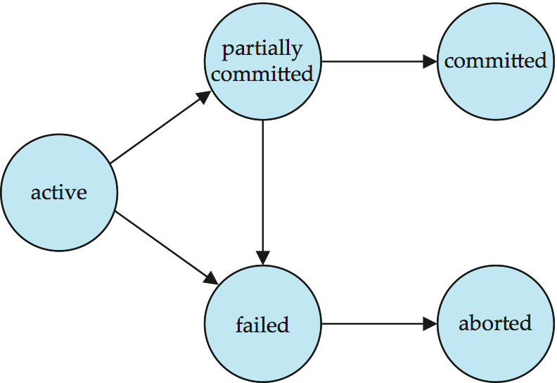
Transaction State (Cont.)
after successful
completion
Final statement
executed
Initial State
Transaction
1. read(A)
2. A := A – 50
3. write(A)
4. read(B)
5. B := B + 50
6. write(B)
When normal
execution
Not possible
Transaction rolled back
& prior database state
Restored & Restarted
Or Killed

Slide 6
Schedules
Schedule – A sequences of instructions that specify the chronological order in which instructions of concurrent transactions are executed.
a schedule for a set of transactions must consist of all instructions of those transactions.
must preserve the order in which the instructions appear in each individual transaction.
A transaction that successfully completes its execution will have a commit instructions as the last statement
by default transaction assumed to execute commit instruction as its last step
A transaction that fails to successfully complete its execution will have an abort instruction as the last statement
Notes:
Schedule tells about- in what chronological order of sequence of instructions of concurrent transactions are to be executed

Slide 7
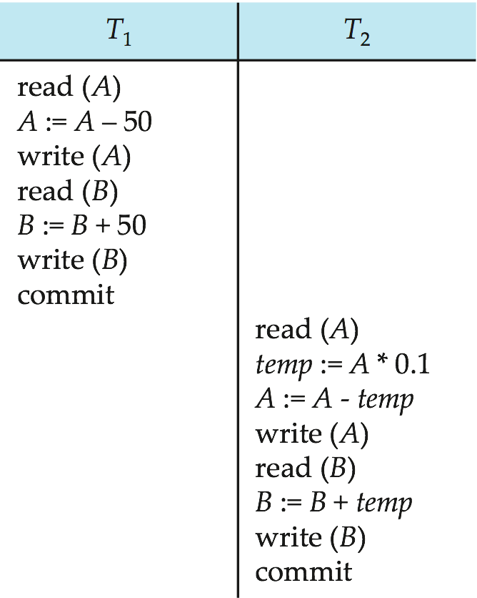
Schedule 1 (Serial)
Let T₁ transfer $50 from A to B, and T₂ transfer 10% of the balance from A to B.
Suppose the current values of accounts A and B are $1000 and $2000.
A serial schedule in which T₁ is followed by T₂ :
The final values of accounts A and B, after the execution in Schedule 1 takes place, are $855 and $2145, respectively.
Thus, the total amount of money in accounts A and B—that is, the sum A + B —is preserved after the execution of both transactions.
At the end of T1 A=950 and B=2050
At the end of T2 A=855 and B=2145
Total Amount in the system is 2145+855=3000
Database consistency maintained.
Notes:
At the ned of T1 A=950 and B=2050
At the end of T2 A=855 and B=2145

Slide 8
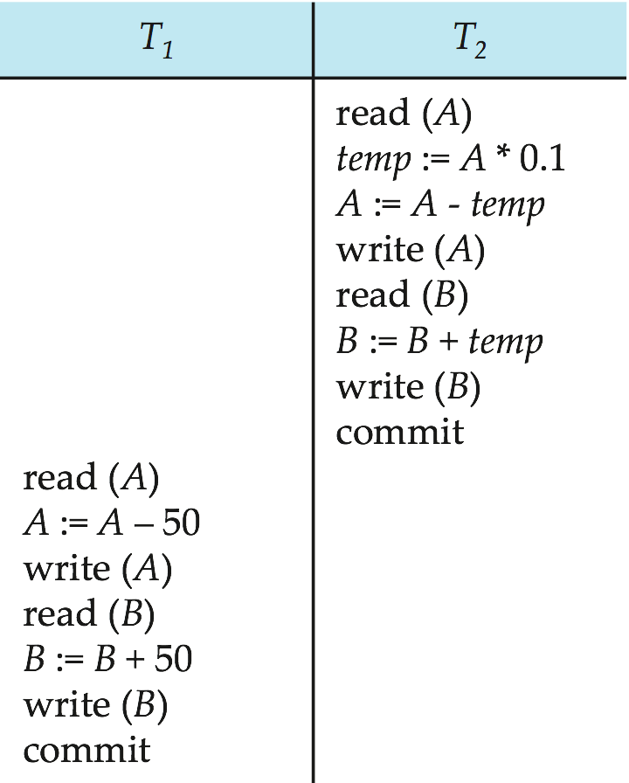
Schedule 2 (Serial)
A serial schedule where T₂ is followed by T₁
Assume current value of A=1000 and B=2000
Similarly, if the transactions are executed one at a time in the order T2 followed by T1, then the corresponding execution sequence is in schedule 2
Again, as expected, the sum A + B is preserved, and the final values of accounts A and B are $850 and $2150, respectively.
At the end of T2 A=900 and B=2100
At the end of T1 A=850 and B=2150
Total Amount in the system is 2150+850=3000
Database consistency maintained.
Notes:
Assume current value of A=1000 and B=2000
At the end of T2 A=900 and B=2100
At the end of T1 A=850 and B=2150

Slide 9
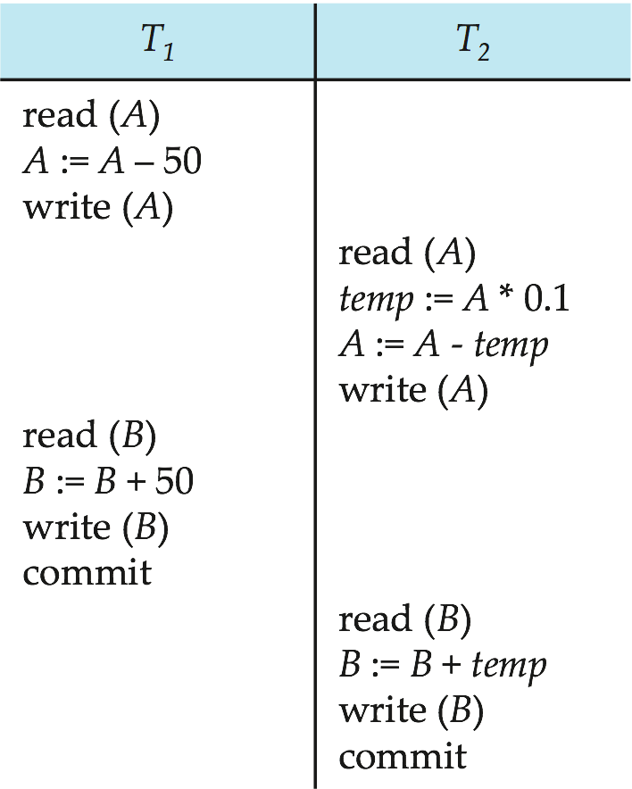
Schedule 3 (Concurrent)
Let T₁ and T₂ be the transactions defined previously. The following schedule is not a serial schedule, but it is equivalent to Schedule 1.
accounts A and B are $1000 and $2000.
Finally A=855 and B=2145 ; A+B=855+2145=3000
–consistency maintained
In Schedules 1, 2 and 3, the sum A + B is preserved.
Notes:
Finally A=855 and B=2145 ; A+B=855+2145=3000 –consistency maintained

Slide 10
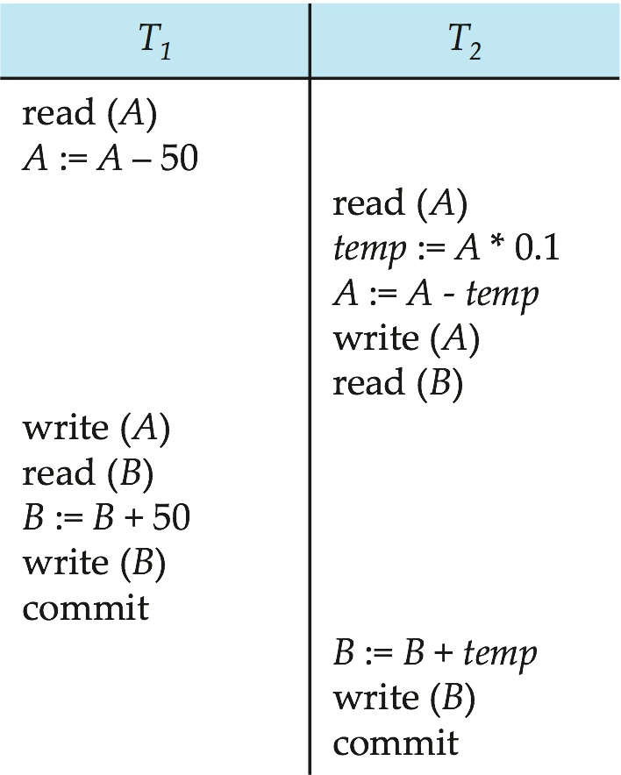
Schedule 4 (Concurrent)
The following concurrent schedule does not preserve the value of (A + B). (Assume initially A=1000/- and B=2000/-)
A=1000
1000-50=950
A =950
B=2000
B=2000+50=2050
B=2050
A =1000
Temp=100
1000-100=900
A=900
B=2000
2000 +100=2100
B=2100
How to check which kind of concurrent Schedule maintain Consistency
Final A=950 and B=2100, now A+B =3050 which violates Consistency
Notes:
If control of concurrent execution is left entirely to the operating system, many
possible schedules, including ones (as in Schedule 4)that leave the database in an inconsistent state,
such as the one just described, are possible. It is the job of the database system to
ensure that any schedule that gets executed will leave the database in a consistent
state. The concurrency-control component of the database system carries out this
task.
We can ensure consistency of the database under concurrent execution by making
sure that any schedule that executed has the same effect as a schedule that could
have occurred without any concurrent execution.
How to check which kind of concurrent Schedule maintain Consistency

Slide 11
Serializability
Basic Assumption – Each transaction preserves database consistency.
Thus serial execution of a set of transactions preserves database consistency.
A (possibly concurrent) schedule is serializable if it is equivalent to a serial schedule.
Different forms of schedule equivalence give rise to the notions of:
1. conflict serializability
2. view serializability
Notes:
SERIAL-The transactions are executed non-interleaved (see example above) i.e., a serial schedule is one in which no transaction starts until a running transaction has ended.
SERIALIZABLE-A schedule (interleaved) that is equivalent (in its outcome) to a serial schedule then interleaved schedule is said to have serializabilty property.
How to determine when a schedule is serializable. Certainly, serial schedules are serializable, but if steps of multiple
transactions are interleaved, it is harder to determine whether a schedule is serializable.
No matter which serial schedule is chosen, serial execution never leaves the database in an inconsistent state, so every serial execution is considered correct,
although different results may be produced. The objective of serializability is to find non-serial(transactions in interleaved fashion)
schedules that allow transactions to execute concurrently without interfering with one
another, and thereby produce a database state that could be produced by a serial execution.
If a set of transactions executes concurrently, we say that the (non-serial) schedule is
correct if it produces the same results as some serial execution. Such a schedule is called
serializable. To prevent inconsistency from transactions interfering with one another, it
is essential to guarantee serializability of concurrent transactions. In serializability, the
ordering of read and write operations is important:
A conflict serializable schedule orders any conflicting operations in the same way as some serial execution

Slide 12
Simplified view of transactions
We ignore operations other than read and write instructions
We assume that transactions may perform arbitrary computations on data in local buffers in between reads and writes.
Our simplified schedules consist of only read and write instructions.

Slide 13
Conflicting Instructions
Assume a schedule S in which there are two consecutive instructions, I and J , of transactions T_{i} and T_{j} , respectively (i ≠ j).
If I and J refer to different data items
then we can swap I and J without affecting the results of any instruction
In the schedule. However,
if I and J refer to the same data item Q, then the order of the two steps may matter.
1. l_{i} = read(Q), l_{j} = read(Q). l_{i} and l_{j} don’t conflict. (can be swapped) 2. l_{i} = read(Q), l_{j} = write(Q). They conflict. (can’t be swapped) 3. l_{i} = write(Q), l_{j} = read(Q). They conflict (can’t be swapped) 4. l_{i} = write(Q), l_{j} = write(Q). They conflict (can’t be swapped)
Intuitively, a conflict between l_{i} and l_{j} forces a (logical) temporal order between them.
If l_{i} and l_{j} are consecutive in a schedule and they do not conflict, their results would remain the same even if they had been interchanged in the schedule.

Slide 14
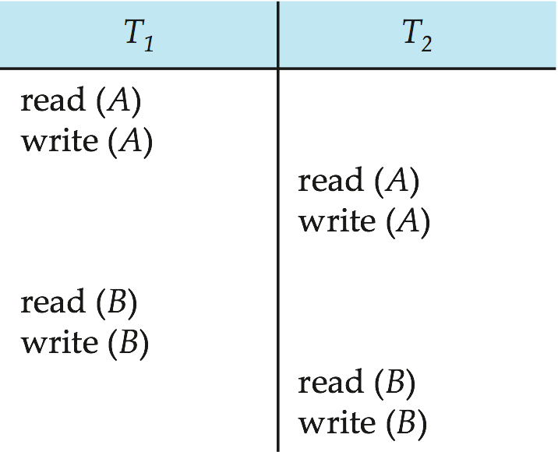
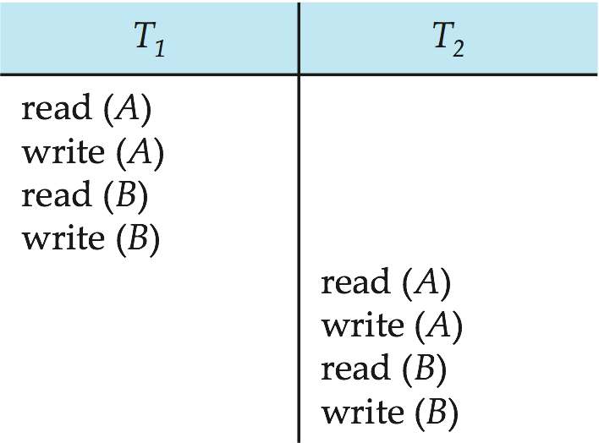
Conflict Serializability
If a schedule S can be transformed into a schedule S’ by a series of swaps of non-conflicting instructions, we say that S and S’ are conflict equivalent.
We say that a schedule S is conflict serializable if it is conflict equivalent to a serial schedule
S
S’
S is conflict serializable
S’ is Conflict Equivalent
Notes:
a transaction schedule is serializable if its outcome (e.g., the resulting database state) is equal to the outcome of its transactions executed serially, i.e. without overlapping in time.
Assume WE generated a schedule S’ by swapping non-conflict instruction in S then S is conflict serializable and S’ is Conflict Equivalent

Slide 15
Conflict Serializability (Cont.)
Schedule 3 can be transformed into Schedule 6, a serial schedule where T₂ follows T₁, by series of swaps of non-conflicting instructions. Therefore Schedule 3 is conflict serializable.
Schedule 3
Schedule 6
Notes:
The write(A) instruction of T1 conflicts with the read(A) instruction
of T2. However, the write(A) instruction of T2 does not conflict with the read(B)
instruction of T1, because the two instructions access different data items.
Since the write(A) instruction of T2 in schedule 3 of Figure 14.6 does not conflict
with the read(B) instruction of T1, we can swap these instructions to generate an
equivalent schedule, schedule 5, in Figure. Regardless of the initial system
state, schedules 3 and 5 both produce the same final system state.
We continue to swap non conflicting instructions:
• Swap the read(B) instruction of T1 with the read(A) instruction of T2.
• Swap the write(B) instruction of T1 with the write(A) instruction of T2.
• Swap the write(B) instruction of T1 with the read(A) instruction of T2.
The final result of these swaps, schedule 6 of Figure , is a serial schedule.
Note that schedule 6 is exactly the same as schedule 1, but it shows only the
read and write instructions.

Slide 16
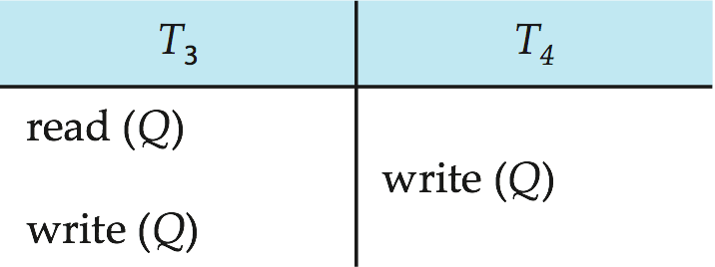
Conflict Serializability (Cont.)
Example of a schedule that is not conflict serializable: (schedule 7)
We are unable to swap instructions in the above schedule to obtain either the serial schedule < T₃, T₄ >, or the serial schedule < T₄, T₃ >.

Slide 17
Example
T1 | T2
Read(A)
 | Read(A)
Read(B)
Write(B)
 | Read(D)
 | Write(D)
Write (A)
 | Read(C)
 | Write(A)
Is it Conflict Serializable?
Notes:
Is it Conflict Serializable? -NO

Slide 18
Concurrency Control

Slide 19
Concurrency Control
Lock-Based Protocols
Timestamp-Based Protocols
Validation-Based Protocols
Multiple Granularity
Multiversion Schemes
Insert and Delete Operations
Concurrency in Index Structures
One of the fundamental properties of a transaction is isolation. When several transactions execute concurrently in the database, however, the isolation property may no longer be preserved.
To ensure that it is, the system must control the interaction among the concurrent transactions; this control is achieved through one of a variety of mechanisms called concurrency control schemes.
Notes:
No one scheme is clearly the best; each one has advantages.
In practice, the most frequently used schemes are two-phase locking and snapshot isolation.

Slide 20
Lock-Based Protocols
One way to ensure serializability is to require that data items be accessed in a mutually exclusive manner
A lock is a mechanism to control concurrent access to a data item
Data items can be locked in two modes :
1. exclusive (X) mode. If a transaction T_{i} has obtained an exclusive- mode lock (denoted by X) on item Q, then T_{i} can both read and write Q.
2. shared (S) mode. If a transaction T_{i} has obtained a shared-mode lock (denoted by S) on item Q, then T_{i} can read, but cannot write, Q.
Lock requests are made to concurrency-control manager.
Transaction can proceed only after request is granted.
Notes:
When several transactions execute concurrently in the database, however, the isolation property may no longer be preserved. To ensure that it is,
the system must control the interaction among the concurrent transactions; this control is achieved through one of a variety of mechanisms called concurrency control
schemes.
One way to ensure serializability is to require that data items be accessed in a mutually exclusive manner; that is, while one transaction is accessing a data item, no other
transaction can modify that data item.
Shared. If a transaction T_{i} has obtained a shared-mode lock (denoted by S) on item Q, then Ti can read, but cannot write, Q.

Slide 21
Lock-Based Protocols (Cont.)
Lock-compatibility matrix
A transaction may be granted a lock on an item if the requested lock is compatible with locks already held on the item by other transactions
Any number of transactions can hold shared locks on an item,
but if any transaction holds an exclusive on the item no other transaction may hold any lock on the item.
If a lock cannot be granted, the requesting transaction is made to wait till all incompatible locks held by other transactions have been released. The lock is then granted.
Let {T₀, T1, . . ., Tn} be a set of transactions participating in a schedule S. We say that Ti precedes Tj in S, written Ti → Tj, if there exists a data item Q such that Ti has held lock mode A (S or X) on Q, and Tj has held lock mode B (S or X) on Q later, and comp(A,B) = false.
If Ti → Tj , then that precedence implies that in any equivalent serial schedule, Ti must appear before Tj .
Notes:
To access a data item, transaction Ti must first lock that item. If the data item is
already locked by another transaction in an incompatible mode, the concurrency control
manager will not grant the lock until all incompatible locks held by other
transactions have been released. Thus, Ti is made to wait until all incompatible
locks held by other transactions have been released.
Transaction Ti may unlock a data item that it had locked at some earlier point.
Note that a transaction must hold a lock on a data item as long as it accesses that
item. Moreover, it is not necessarily desirable for a transaction to unlock a data
item immediately after its final access of that data item, since serializability may
not be ensured.

Slide 22
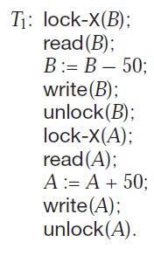
Lock-Based Protocols (Cont.)
Example of a transaction performing locking (serially (T₁, T₂) OR (T₂,T₁ )) :
T₂: lock-S(A);
read (A);
unlock(A);
lock-S(B);
read (B);
unlock(B);
display(A+B)
If the transactions are executed serially, either in the order T1, T2 or the
order T2, T1, then transaction T2 will display the value $300. No Loss of Consistency.
If, however, these transactions are executed concurrently, (see schedule 1 next slide) then in this case, transaction T2 displays $250, which is incorrect. The reason for this mistake is that the transaction T1 unlocked data item B too early, as a result of which T2 saw an inconsistent state.
if A and B get updated in-between the read of A and B, the displayed sum would be wrong.
Assume A=100 & B=200
Notes:
Suppose that the values of accounts A and B are $100 and $200, respectively.
If these two transactions are executed serially, either in the order T1, T2 or the
order T2, T1, then transaction T2 will display the value $300.
But if executed concurrently as in next slide , consistency not preserved ,because A+B displays $300

Slide 23
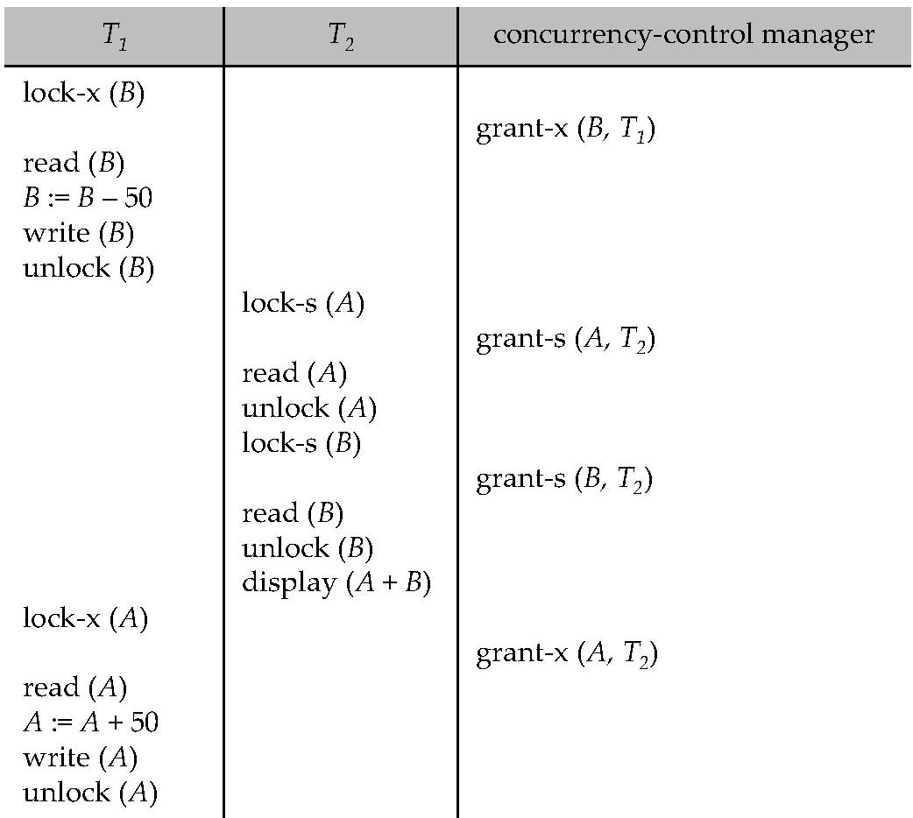
Schedule 1-Concurent
Assume A=100 & B=200
If, however, these transactions are executed concurrently, then schedule 1
In this case, transaction T₂ displays $250, which is incorrect.
Following table is containing only Transaction statements executing in concurrent fashion , but to maintain consistency , we have to get lock on the data item before processing that data, which is shown in the left side table.
T1 | T2
read(B)
B:=B-50
write(B)
 | read(A)
 | read(B)
 | display(A+B)
read(A)
A:=A+50
write(B)
Reason is -T1 unlocked data item B too early.
What if hold lock for longer duration ?
A locking protocol is a set of rules followed by all transactions while requesting and releasing locks. Locking protocols restrict the set of possible schedules.
Notes:
The reason for this mistake is that the
transaction T1 unlocked data item B too early, as a result of which T2 saw an inconsistent state.

Slide 24
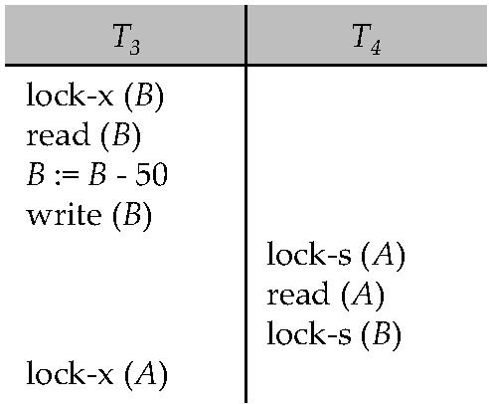
Pitfalls of Lock-Based Protocols (Deadlock)
Consider the partial schedule
Neither T₃ nor T₄ can make progress — executing lock-S(B) causes T₄ to wait for T₃ to release its lock on B, while executing lock-X(A) causes T₃ to wait for T₄ to release its lock on A.
Such a situation is called a deadlock.
To handle a deadlock one of T₃ or T₄ must be rolled back and its locks released.
locking can lead to an undesirable situation- Deadlock
Notes:
Consider the partial schedule above for T3 and T4. Since T3 is holding an exclusive mode
lock on B and T4 is requesting a shared-mode lock on B, T4 is waiting for
T3 to unlock B. Similarly, since T4 is holding a shared-mode lock on A and T3 is
requesting an exclusive-mode lock on A, T3 is waiting for T4 to unlock A. Thus, we
have arrived at a state where neither of these transactions can ever proceed with
its normal execution. This situation is called deadlock. When deadlock occurs, the
system must roll back one of the two transactions. Once a transaction has been
rolled back, the data items that were locked by that transaction are unlocked.
These data items are then available to the other transaction, which can continue
with its execution.

Slide 25
Pitfalls of Lock-Based Protocols (Deadlock)
If we do not use locking, or if we unlock data items as soon as possible after reading or writing them, we may get inconsistent states.
On the other hand, if we do not unlock a data item before requesting a lock on another data item, deadlocks may occur.
Which one to Choose ? Deadlock or getting into inconsistent state
Deadlocks are definitely preferable to inconsistent states, since they can be handled by rolling back of transactions, whereas
Inconsistent states may lead to real-world problems that cannot be handled by the database system.
We shall require that each transaction in the system follow a set of rules, called a locking protocol, indicating when a transaction may lock and unlock each of the data items.
Locking protocols restrict the number of possible schedules. The set of all such schedules is a proper subset of all possible serializable schedules.
Notes:
Which one to Choose ? Allowing Dead lock (i.e. (if Locking used) or Getting into Inconsistent state (i.e. (if Locking NOT used) ).
We have methods to handle dead lock (one way is to Roll back transaction causing deadlock), but no method for for inconsistent state.

Slide 26
Pitfalls of Lock-Based Protocols (Cont.)
The potential for deadlock exists in most locking protocols. Deadlocks are a necessary evil.
Starvation is also possible if concurrency control manager is badly designed. For example:
A transaction may be waiting (T₁) for an X-lock on an item, while a sequence of other transactions (T₂,T_{3,..}) request and are granted an S-lock on the same item.
The same transaction (T₁) is repeatedly rolled back due to deadlocks.
Concurrency control manager can be designed to prevent starvation
We can avoid starvation of transactions by granting locks in the following manner:
When a transaction T_{i} requests a lock on a data item Q in a particular mode M, the concurrency-control manager grants the lock provided that:
1. There is no other transaction holding a lock on Q in a mode that conflicts with M.
2. There is no other transaction that is waiting for a lock on Q and that made its lock request before T_{i} .
Notes:
Discuss deadlock and starvation problem in lock based protocol and what strategy in granting locks can avoid starvation?

Slide 27
The Two-Phase Locking Protocol
This is a protocol which ensures conflict-serializable schedules.
Phase 1: Growing Phase
transaction may obtain locks
transaction may not release locks
Phase 2: Shrinking Phase
transaction may release locks
transaction may not obtain locks
The protocol assures serializability.
The two-phase locking protocol ensures conflict serializability.
Consider any transaction. The point in the schedule where the transaction has obtained its final lock (the end of its growing phase) is called the lock point of the transaction. Now, transactions can be ordered according to their lock points this ordering is, in fact, a serializability ordering for the transactions.
Notes:
Explain 2-phase locking strategy and justify 2-phase locking protocol ensures conflict serializability.

Slide 28
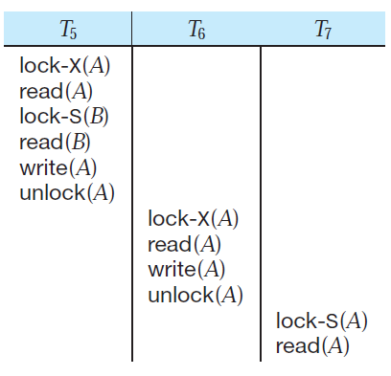
Pitfall in 2-phase Locking
In addition to being serializable, schedules should be cascade less. Cascading rollback may occur under two-phase locking.
consider the partial schedule given below-
Each transaction
observes the two-phase locking protocol, but the failure of T₅ after the read(A) step of T₇ leads to cascading rollback of T₆ and T₇.
failure of T₅
after the
read(A)
step of T₇
Notes:
Discuss the pitfall(demerit) in the 2-phase locking with an example. Do not write only content given in the slide , elaborate by reading book.

Slide 29
The Two-Phase Locking Protocol (Cont.)
Two-phase locking does not ensure freedom from deadlocks
( see the schedule containing T3 & T4 )
Cascading roll-back is possible under two-phase locking.
To avoid this, follow a modified protocol called strict two-phase locking.
Here a transaction must hold all its exclusive locks till it commits/aborts.
This requirement ensures that any data written by an uncommitted transaction are locked in exclusive mode until the transaction commits, preventing any other transaction from reading the data.
Rigorous two-phase locking is even stricter: here all locks are held till commit/abort. In this protocol transactions can be serialized in the order in which they commit.
Notes:
Explain 2-phase locking method with an example and also discuss other two-variations of it.
What are the two variations of 2-Phase locking protocol to avoid cascading rollback problem.

Slide 30
Lock Conversions-Why?
Assume that two-phase locking protocol is used in T8 & T9 schedule execution.
T8 must lock a1 in exclusive mode.
Therefore, any concurrent execution of both transactions amounts to a serial execution.
Note- T8 needs an exclusive lock on a1 only at the end of its execution, when it writes a1.
Thus, if T8 could initially lock a1 in shared mode, and
then could later change the lock to exclusive mode, we could get more concurrency.
Therefore T8 and T9 could also access a1 and a2 simultaneously.
This observation leads us to a refinement of the basic two-phase locking protocol, i.e. lock conversions .
Therefore a mechanism for upgrading a shared lock to an exclusive lock, and downgrading an exclusive lock to a shared lock.

Slide 31
Lock Conversions
Two-phase locking with lock conversions:
– First Phase: (growing)
can acquire a lock-S on item
can acquire a lock-X on item
can convert a lock-S to a lock-X (upgrade)
– Second Phase: (shrinkage)
can release a lock-S
can release a lock-X
can convert a lock-X to a lock-S (downgrade)
This protocol assures serializability.
Lock conversion cannot be allowed arbitrarily. but, upgrading can take place in only the growing phase, whereas downgrading can take place in only the shrinking phase.
Notes:
Explain lock conversion method in 2-phase locking with an example .What is its necessity of Lock Conversion?
What are the drawbacks of 2Phase with lock conversion algorithm?
Strict two-phase locking and rigorous two-phase locking (with lock conversions)
are used extensively in commercial database systems.

Slide 32
Automatic Acquisition of Locks
Widely used scheme automatically generates the appropriate lock and unlock instructions for a transaction, on the basis of read and write requests from the transaction
A transaction T_{i} issues the standard read/write instruction, without explicit locking calls.
The operation read(D) is processed as:
if T_{i} has a lock on D
then
read(D)
else begin
if necessary wait until no other
transaction has a lock-X on D
grant T_{i} a lock-S on D;
read(D)
end
Notes:
A simple but widely used scheme automatically generates the appropriate
lock and unlock instructions for a transaction, on the basis of read and write
requests from the transaction:
• When a transaction Ti issues a read(Q) operation, the system issues a lock-
S(Q) instruction followed by the read(Q) instruction.
• When Ti issues a write(Q) operation, the system checks to see whether Ti
already holds a shared lock on Q. If it does, then the system issues an upgrade(
Q) instruction, followed by the write(Q) instruction. Otherwise, the
system issues a lock-X(Q) instruction, followed by the write(Q) instruction.
• All locks obtained by a transaction are unlocked after that transaction commits
or aborts.

Slide 33
Automatic Acquisition of Locks (Cont.)
write(D) is processed as:
if T_{i} has a lock-X on D
then
write(D)
else begin
if necessary wait until no other trans. has any lock on D,
if T_{i} has a lock-S on D
then
upgrade lock on D to lock-X
else
grant T_{i} a lock-X on D
write(D)
end;
All locks are released after commit or abort
Notes:
Discuss Automatic Lock acquisition technique based on Read and Write instructions in transactions.
A simple but widely used scheme automatically acquisition of appropriate lock
and unlock instructions for a transaction, on the basis of read and write requests
from the transaction:
• When a transaction Ti issues a read(Q) operation, the system issues a lock-
S(Q) instruction followed by the read(Q) instruction.
• When Ti issues a write(Q) operation, the system checks to see whether Ti
already holds a shared lock on Q. If it does, then the system issues an upgrade(
Q) instruction, followed by the write(Q) instruction. Otherwise, the system
issues a lock-X(Q) instruction, followed by the write(Q) instruction.
• All locks obtained by a transaction are unlocked after that transaction commits
or aborts.

Slide 34
Implementation of Locking
A lock manager can be implemented as a separate process to which transactions send lock and unlock requests
The lock manager replies to a lock request by sending a lock grant messages (or a message asking the transaction to roll back, in case of a deadlock)
The requesting transaction waits until its request is answered
The lock manager maintains a data-structure called a lock table in shared memory to record granted locks and pending requests
The lock table is usually implemented as an in-memory hash table indexed on the name of the data item being locked
Notes:
The lock manager uses this data structure: For each data item that is currently
locked, it maintains a linked list of records, one for each request, in the order in
which the requests arrived. It uses a hash table, indexed on the name of a data
item, to find the linked list (if any) for a data item; this table is called the lock
table. Each record of the linked list for a data item notes which transaction made
the request, and what lock mode it requested. The record also notes if the request
has currently been granted.

Slide 35
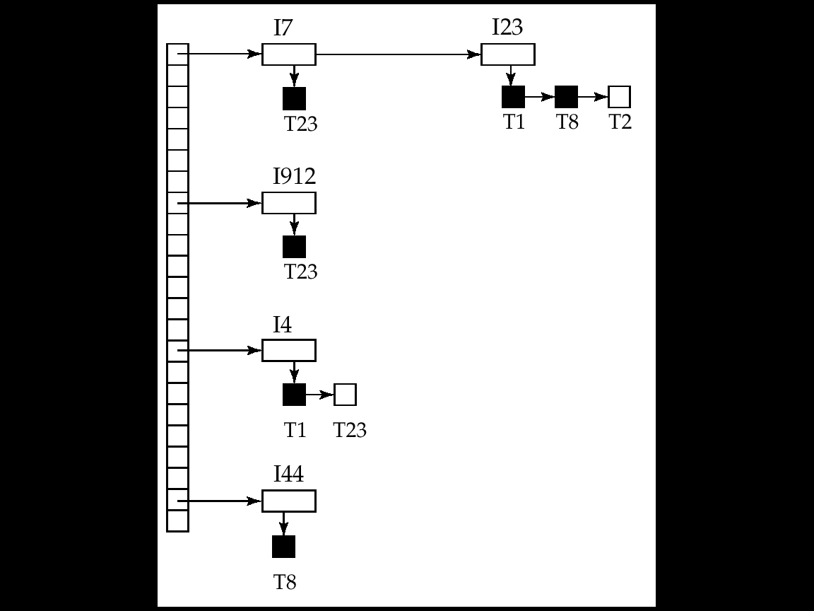
Lock Table
The table contains locks for five
different data items, I4, I7, I23, I44, and I912.
Black rectangles indicate granted locks, white ones indicate waiting requests
Lock table also records the type of lock granted or requested
New request is added to the end of the queue of requests for the data item, and granted if it is compatible with all earlier locks
Unlock requests result in the request being deleted, and later requests are checked to see if they can now be granted
If transaction aborts, all waiting or granted requests of the transaction are deleted
lock manager may keep a list of locks held by each transaction, to implement this efficiently
For example: A list for T1, such as- I23,I4
Notes:
The table contains locks for
five different data items, I4, I7, I23, I44, and I912. The lock table uses overflow
chaining, so there is a linked list of data items for each entry in the lock table.
There is also a list of transactions that have been granted locks, or are waiting for
locks, for each of the data items. Granted locks are the rectangles filled in a darker
shade, while waiting requests are the rectangles filled in a lighter shade. We have
omitted the lock mode to keep the figure simple.
of locks held by a given transaction.
The lock manager processes requests this way:
• When a lock request message arrives, it adds a record to the end of the linked
list for the data item, if the linked list is present. Otherwise it creates a new
linked list, containing only the record for the request.
It always grants a lock request on a data item that is not currently locked.
But if the transaction requests a lock on an item on which a lock is currently
held, the lock manager grants the request only if it is compatible with the locks
that are currently held, and all earlier requests have been granted already.
Otherwise the request has to wait.
• When the lock manager receives an unlock message from a transaction, it
deletes the record for that data item in the linked list corresponding to that
transaction. It tests the record that follows, if any, as described in the previous
paragraph, to see if that request can now be granted. If it can, the lock manager
grants that request, and processes the record following it, if any, similarly,
and so on.
• If a transaction aborts, the lock manager deletes any waiting request made
by the transaction. Once the database system has taken appropriate actions
to undo the transaction, it releases all locks held by the
aborted transaction.

Slide 36
END

